Slide 1
Exploratory Data Analysis of earthQUAKES
Dejan Gjer

Slide 2



Dataset

Slide 3
About dataset
The Significant Earthquake Database is a global listing of over 6,200 earthquakes from 2150 BC to the present
Earthquake is significant if:
Caused deaths
Caused 1M $ damage or more
Magnitude 7.5 or greater
Mercalli scale X or greater
Generated tsunami

Slide 4
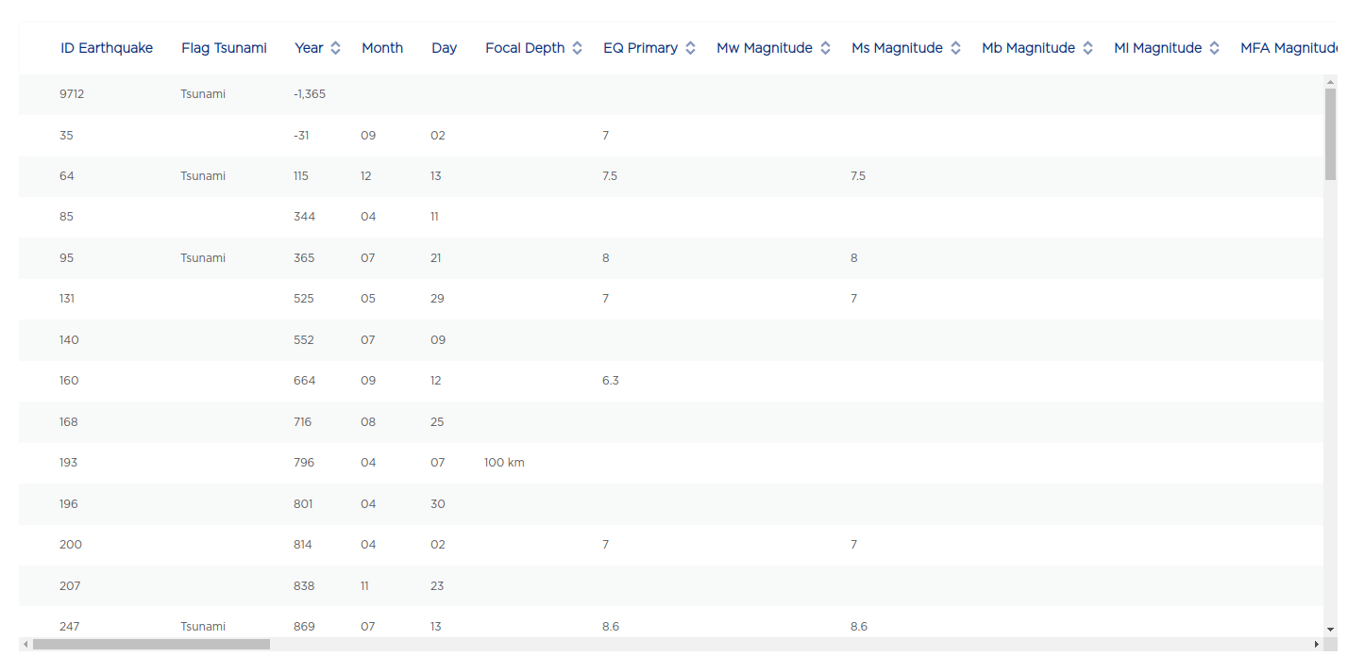
How dataset looks like

Slide 5
Dataset column splits
Columns were split into some categories
Basic earthquake info
Date
Location
Magnitudes
Earthquake effects
Total earthquake effects

Slide 6
Basic earthquake info
Focal Depth - depth of epicenter in kilometers
EQ Primary - magnitude of earthquake (primary measured magnitude) from 1 to 10
Intensity - modified Mercalli intensity from 1 to 12
Flag Tsunami - true if tsunami earthquake trigged tsunami

Slide 7
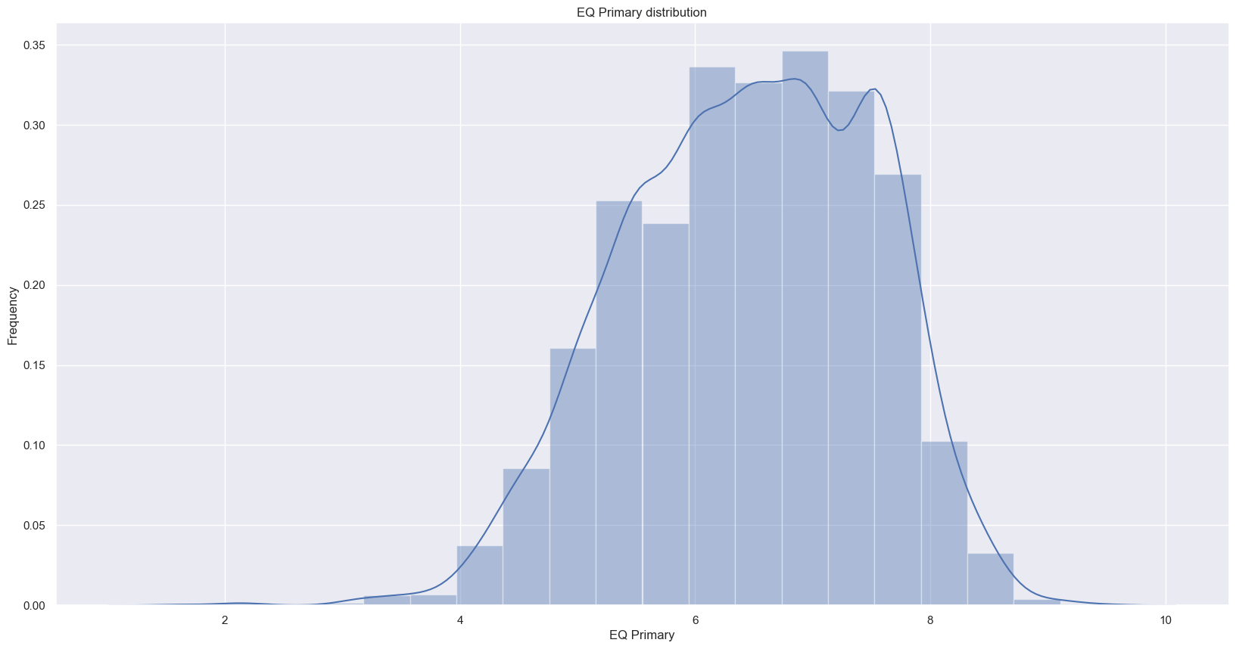
Distribution of magnitude values

Slide 8
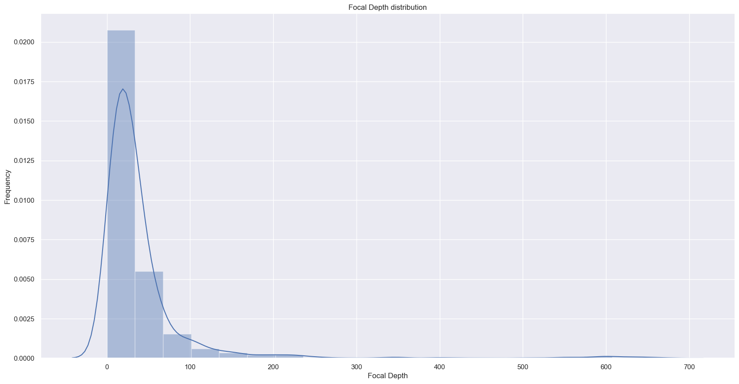
FOcal depth distribution

Slide 9
Location data
Coordinates - (latitude, longitude) - this will be split into two columns
Country
State – only for USA states (not going to be used)
Location name
Region code – will not be used

Slide 10
Date columns
Year
Month
Day

Slide 11
magnitudes
Measure of seismic energy
Logarithmic scale
Magnitude types:
Mw
Ms
Mb
Ml
Mfa
Unknown magnitude

Slide 12
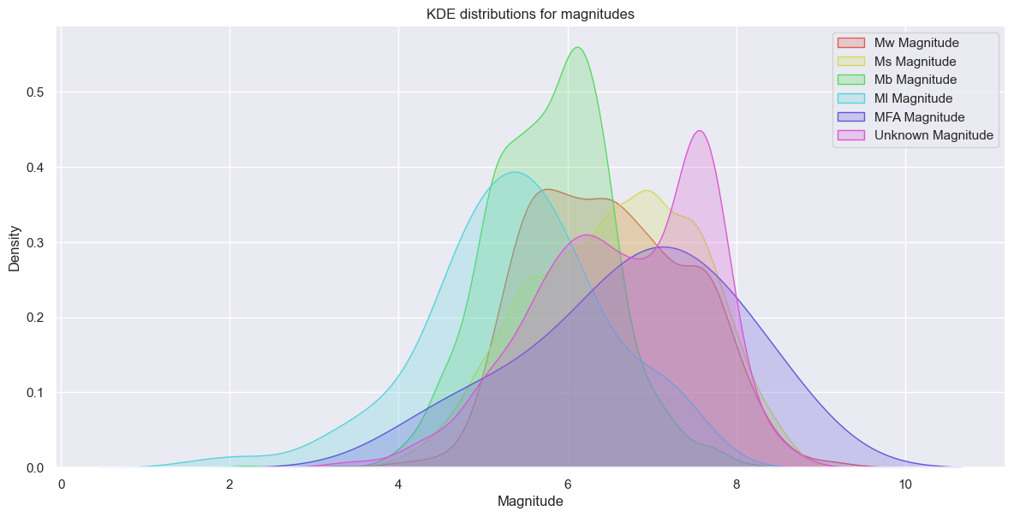
Magnitude distributions

Slide 13
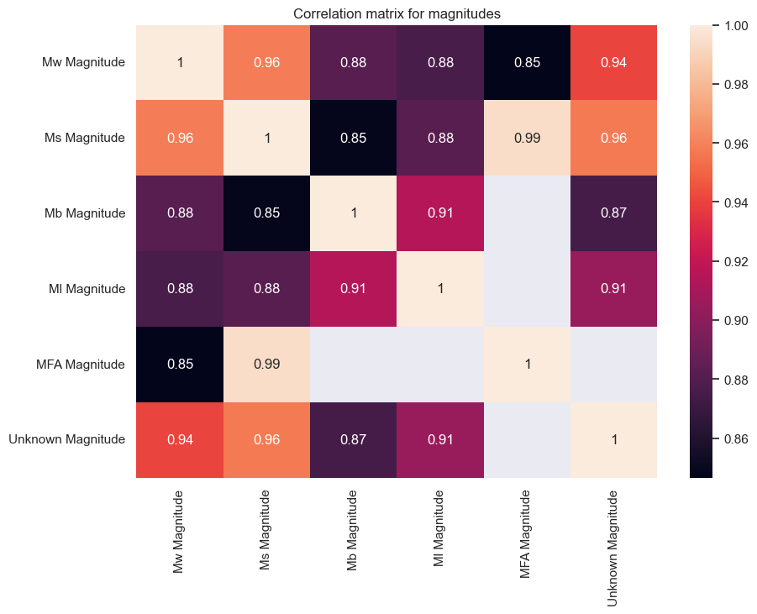
Magnitude correlations
We can notice many high correlatated columns

Slide 14
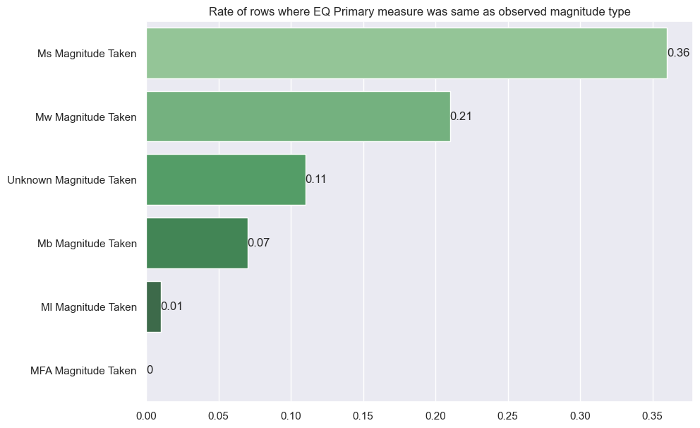
Which magnitude was taken for primary?

Slide 15
Earthquake effects
Numerical columns:
Earthquake : Deaths
Earthquake : Missing
Earthquake : Injuries
Earthquake : Damage (in M$)
Earthquake : Houses Destroyed
Earthquake : Houses Damaged
Categorical columns:
Earthquake : Deaths Description
Earthquake : Missing Description
Earthquake : Injuries Description
Earthquake : Damage Description
Earthquake : Houses Destroyed Description
Earthquake : Houses Damaged Description

Slide 16
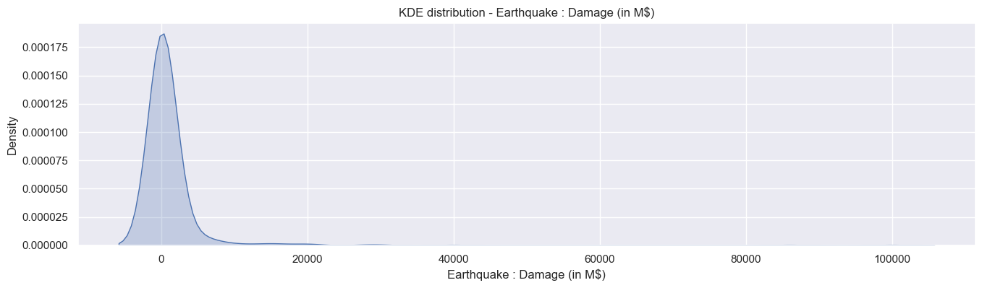
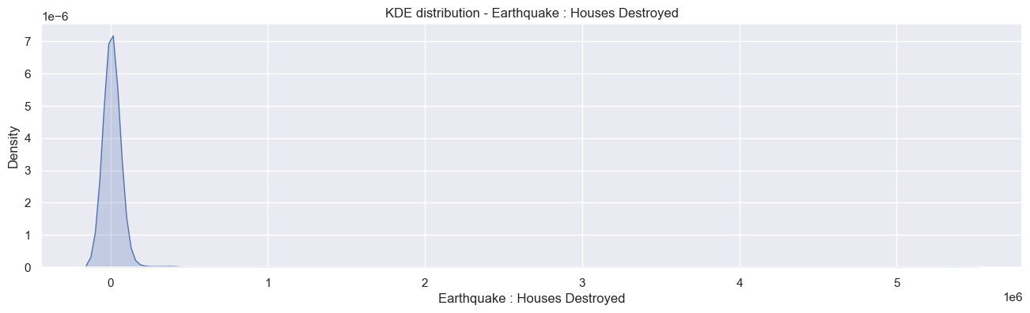
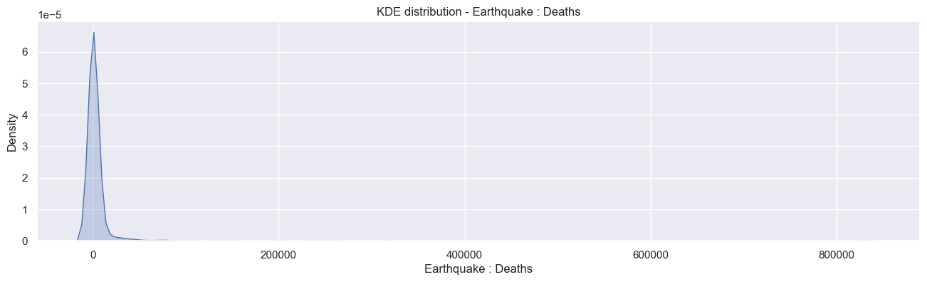
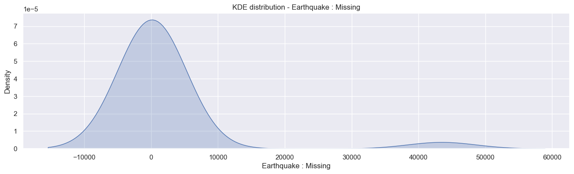
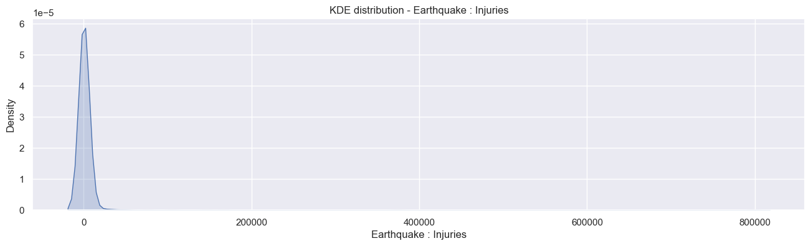
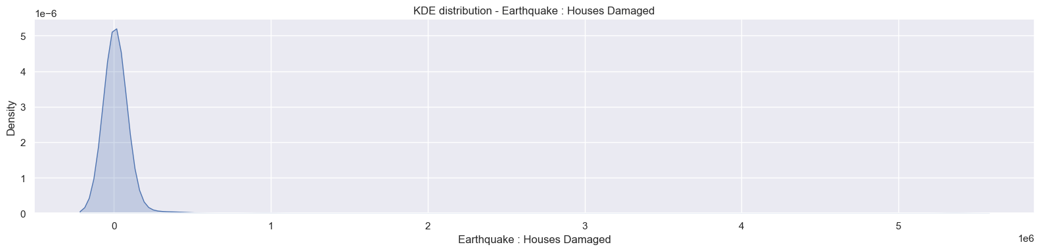
KDE distributions of numerical columns

Slide 17
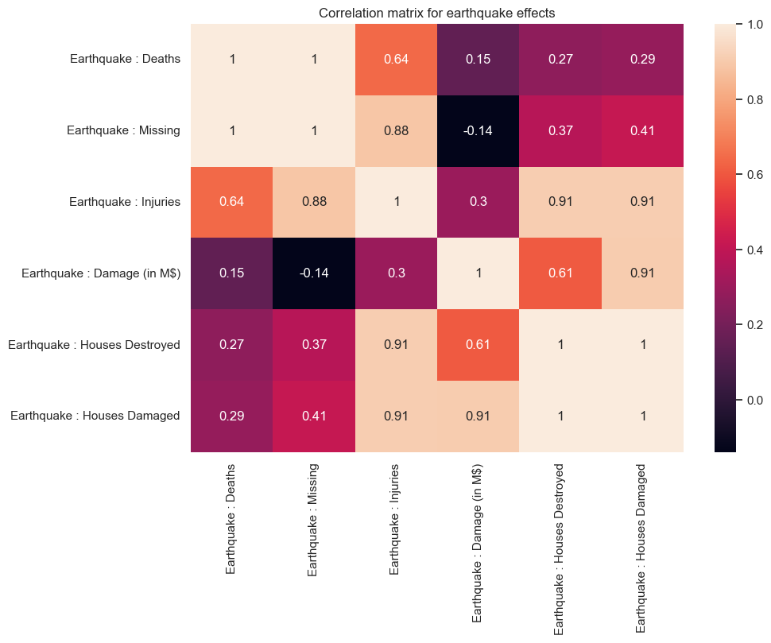
Earthquake effects correlation
We can notice many high correlation values (deaths, missing) and (damage, houses destroyed, houses damaged, injuries)

Slide 18
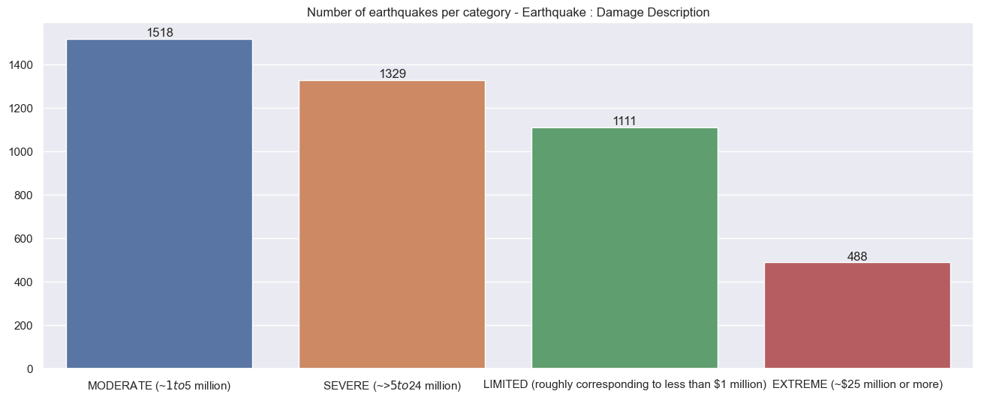
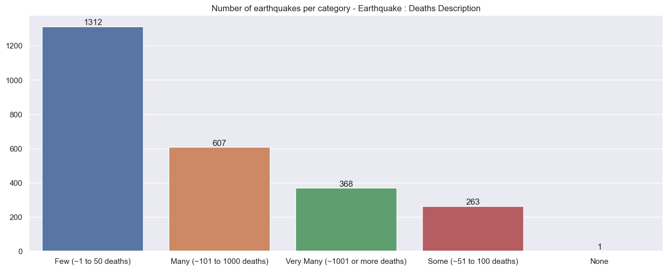
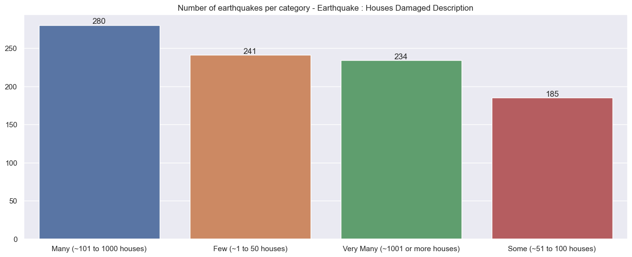
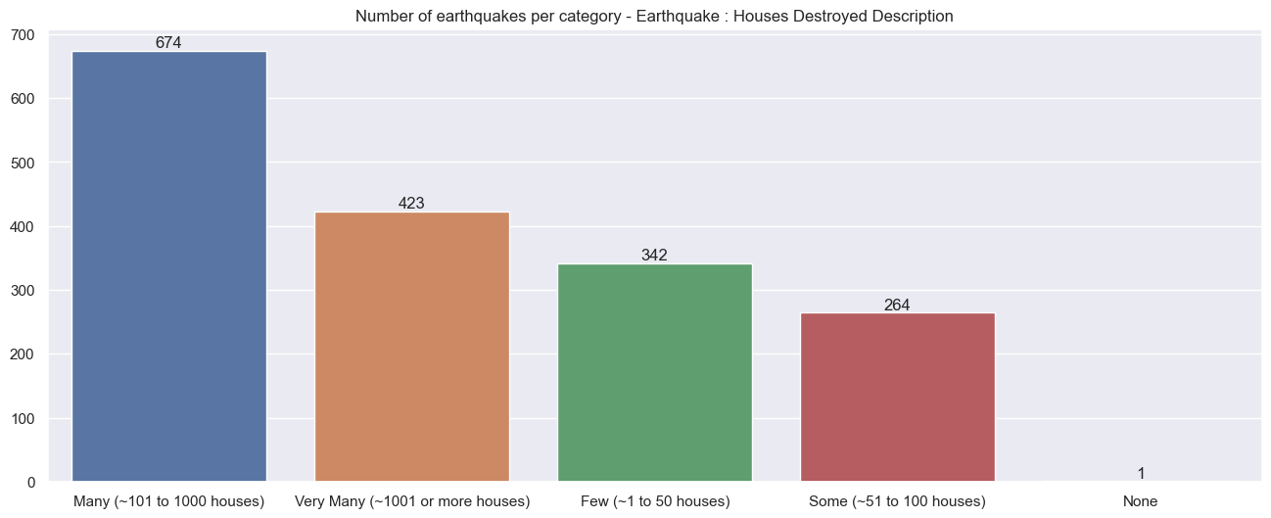
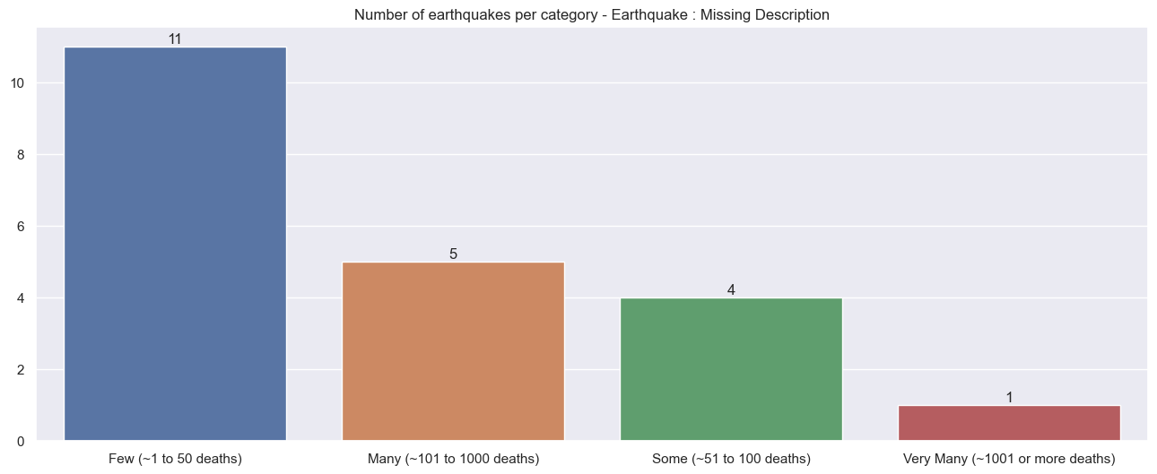
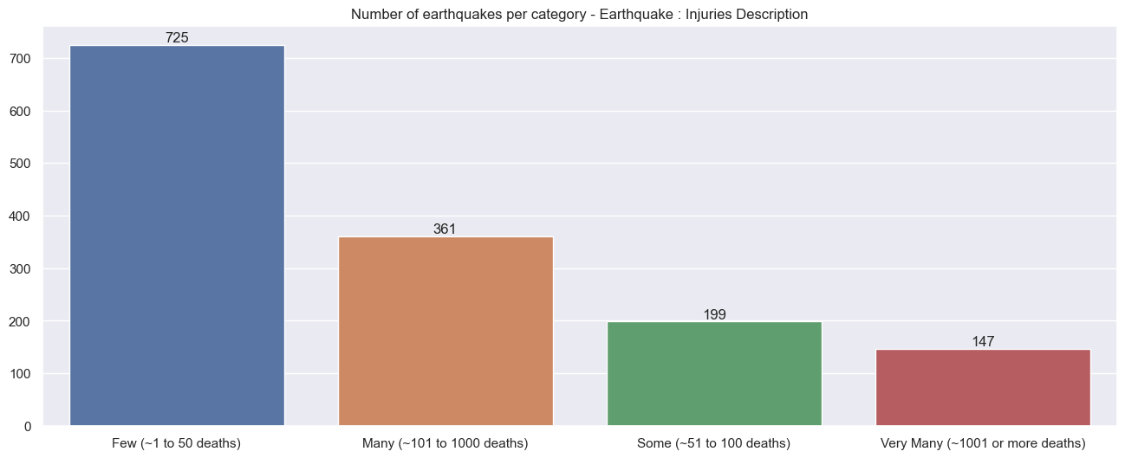
Distributions of categorical values

Slide 19
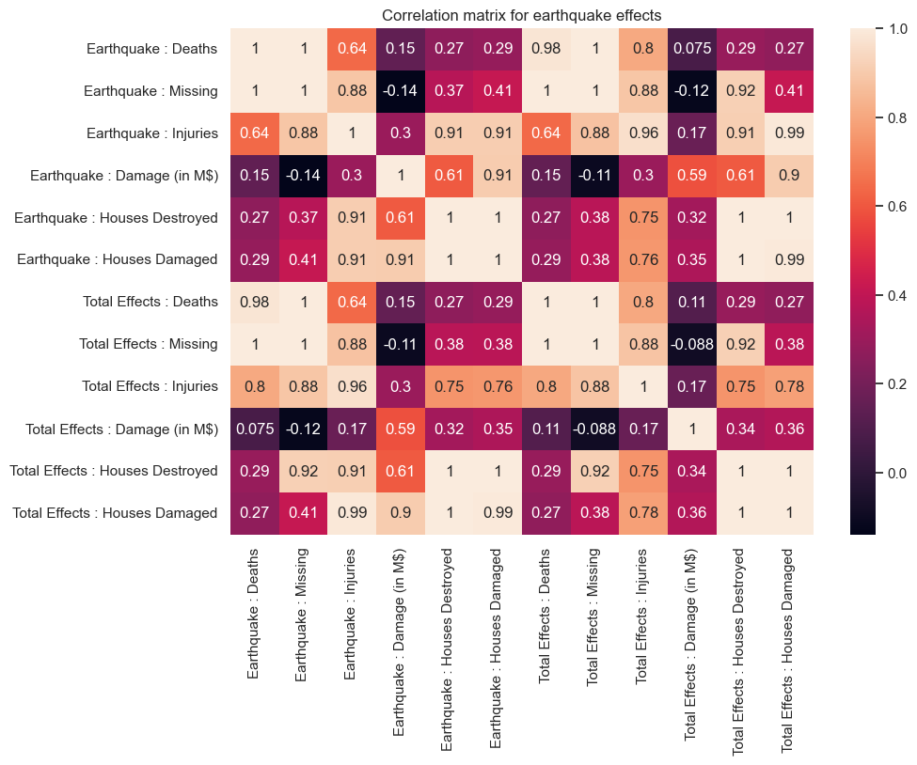
Correlation between earthquake and total effects
Except Damage (in M$) column other pairs of columns are very highly correlated and there is no point on analysing both earthquake and total effects separately for numerical columns.

Slide 20
CORRELATION BETWEEN EARTHQUAKE AND TOTAL EFFECTS
Jaccard similarity for categorical columns Earthquake :
Deaths Description, Total Effects : Deaths Description -> 0.9559331290243338
Earthquake : Missing Description, Total Effects : Missing Description -> 0.9035087719298246
Earthquake : Injuries Description, Total Effects : Injuries Description -> 0.9859108466575434
Earthquake : Damage Description, Total Effects : Damage Description -> 0.9573823255610486
Earthquake : Houses Destroyed Description, Total Effects : Houses Destroyed Description -> 0.9513708535574468
Earthquake : Houses Damaged Description, Total Effects : Houses Damaged Description -> 0.9309467061931035

Slide 21

Feature engineering

Slide 22
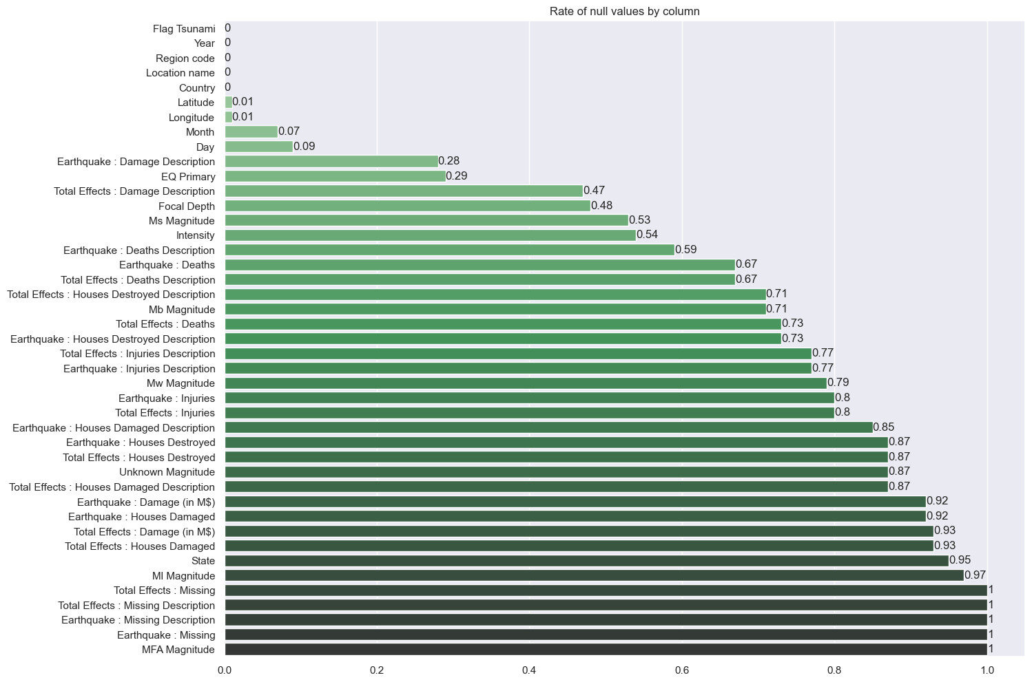
Percentage of null values

Slide 23
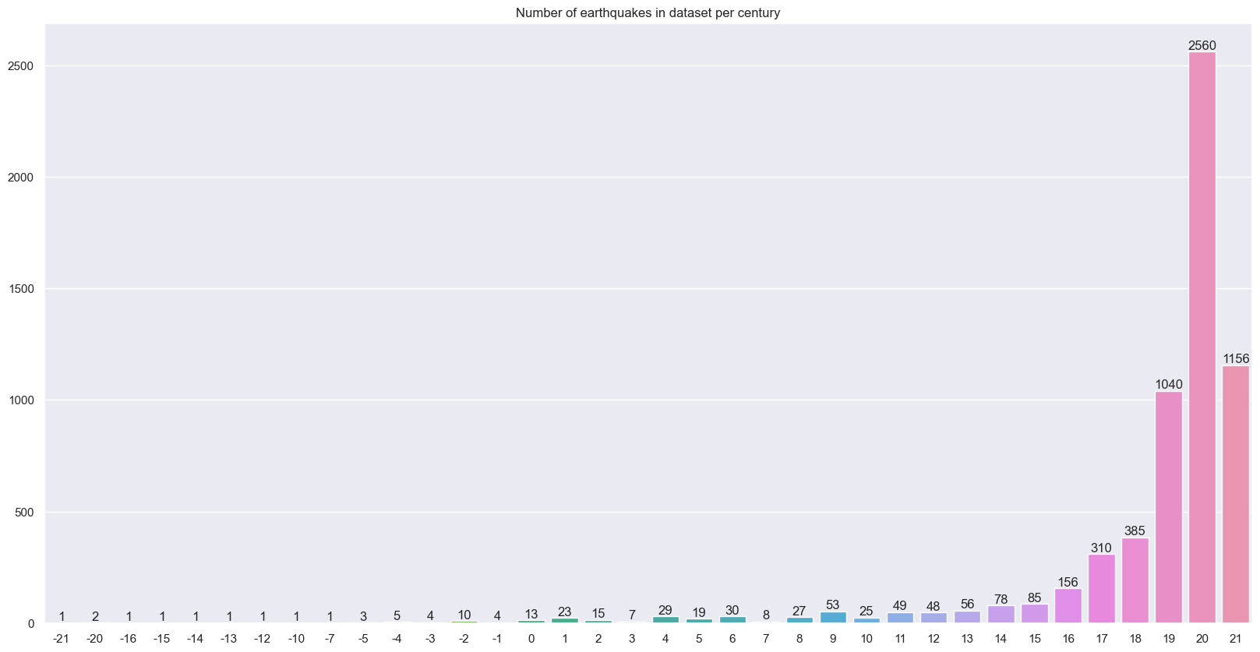
Number of earthquakes per century

Slide 24
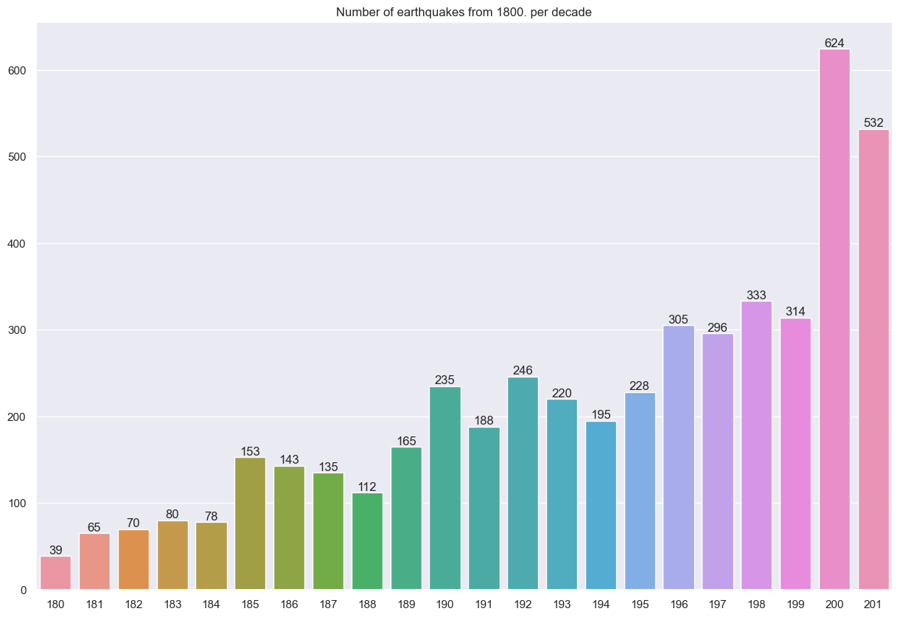
Number of earthquakes per decades – from 1800. year

Slide 25
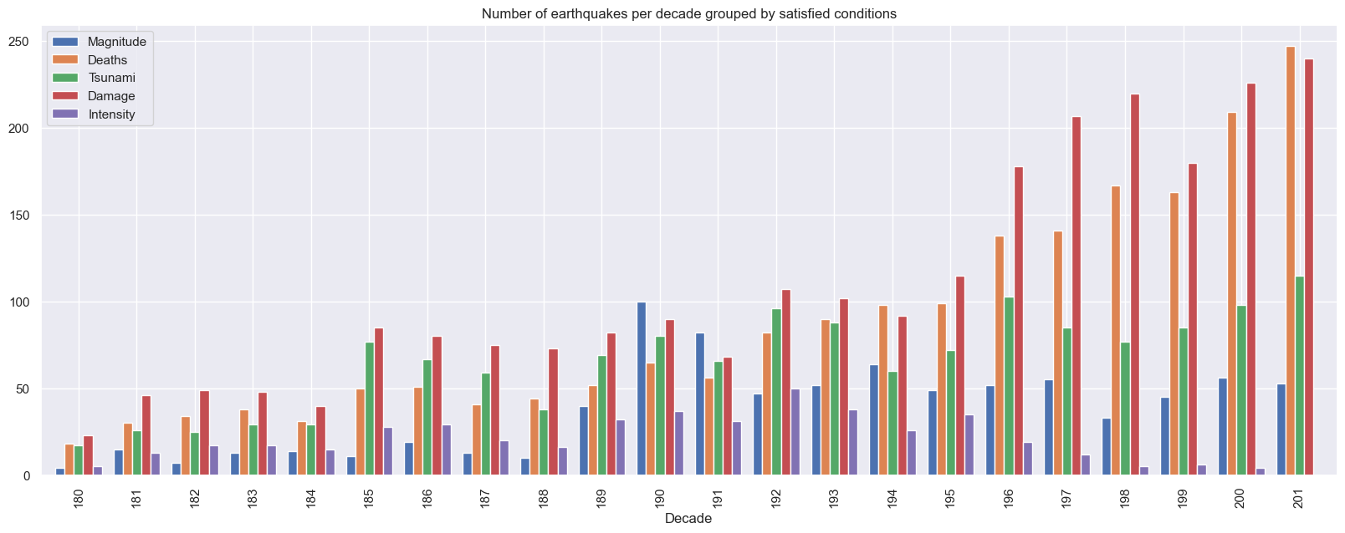
What are causes of earthquakes being significant?

Slide 26
What columns are we going to keep?
From basic data - everything except intensity (too many null values)
From location - coordinates, country, location name
From time – all
From magnitudes – nothing (we will use only EQ Primary)
From earthquake effects - damage, deaths (numerical and categorical), injuries (numerical and categorical
From total effects – nothing (too high correlation with earthquake effects)

Slide 27
conclusions
Main takeaway here is that earthquakes that have enough damage or number of deaths to be classified as significant increased a lot in more recent decades
We can also observe that number of tsunamis as a cause in most of decades (from 1850. to now) did not changed a lot
This can be due to more advanced technology that allows better tracking of material damage and deaths in earthquakes
We will keep only data from 1960-2020. Years, for further analysis

Slide 28

Statistics by time

Slide 29
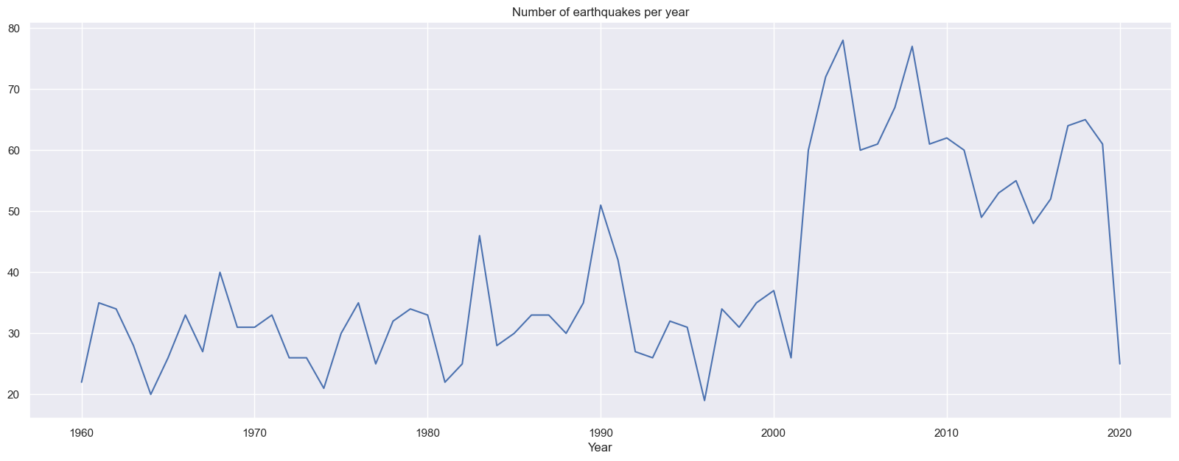
Number of earthquakes per year

Slide 30
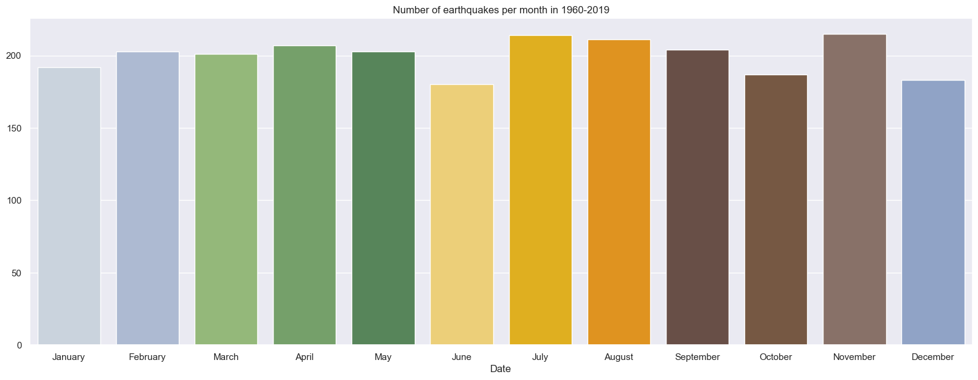
Number of years per month

Slide 31
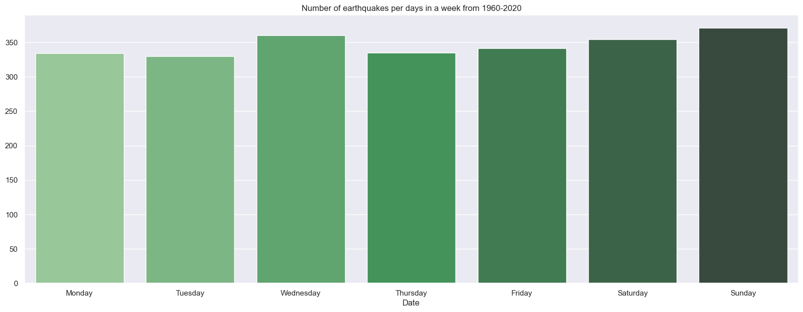
Number of earthquakes per days in week

Slide 32
conclusions
We have increase in number of earthquakes in last two decades
We concluded previously that is due to more earthquakes categorized as significant by damage and death counts (probably better tracking technologies in recent years)
We cannot find some pattern in terms when earthquakes happen the most (period of week, days, etc.)

Slide 33
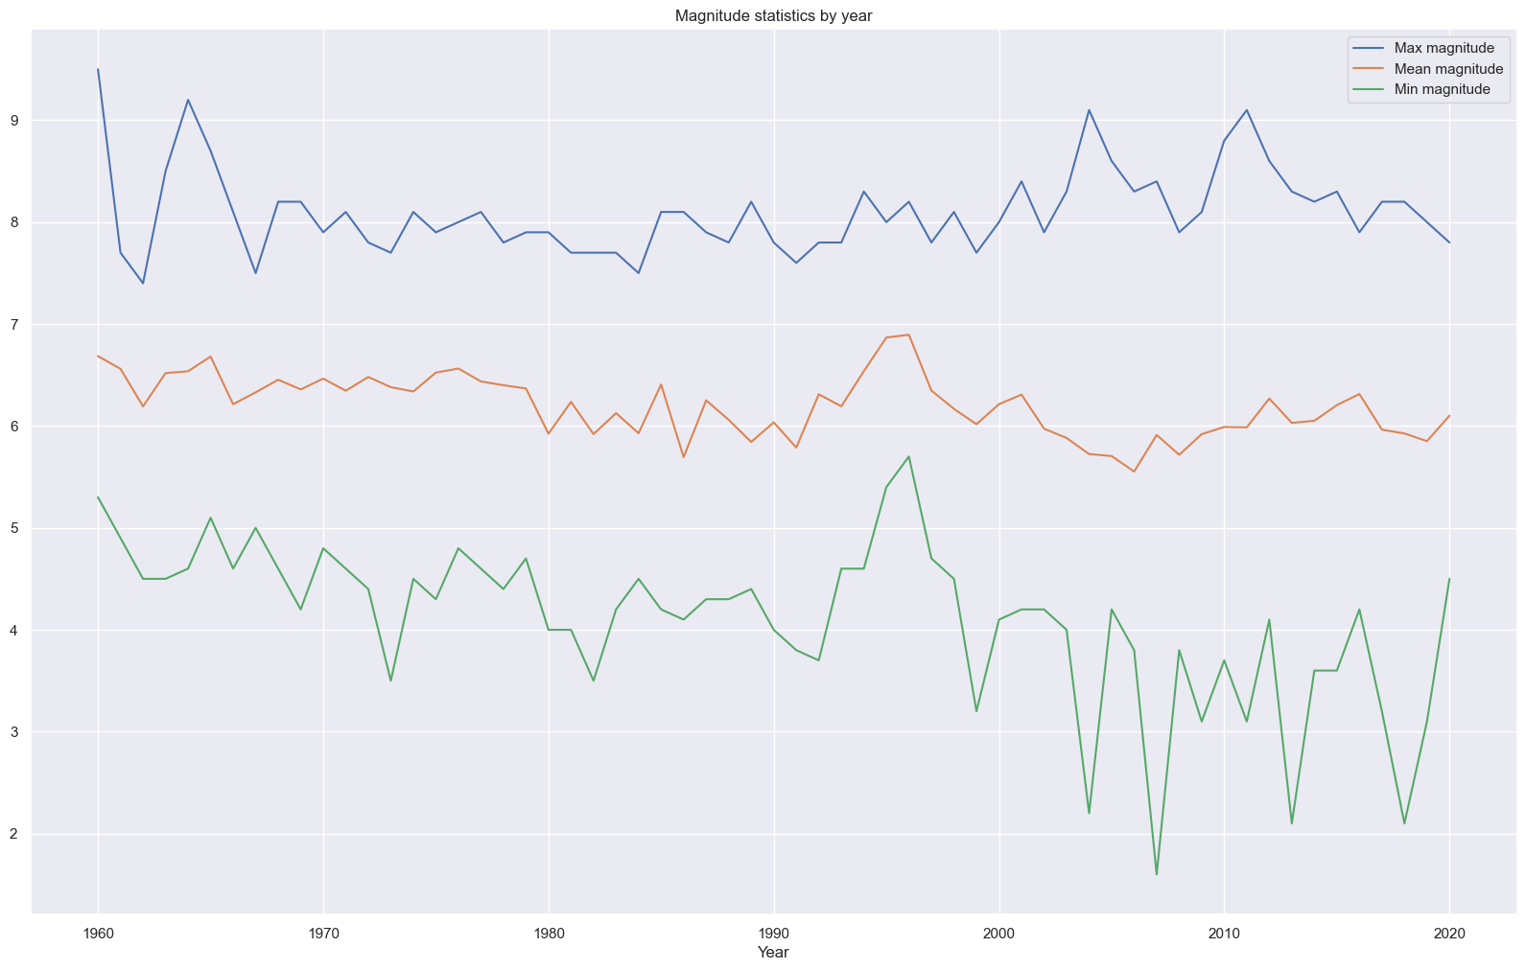
Magnitude over years

Slide 34
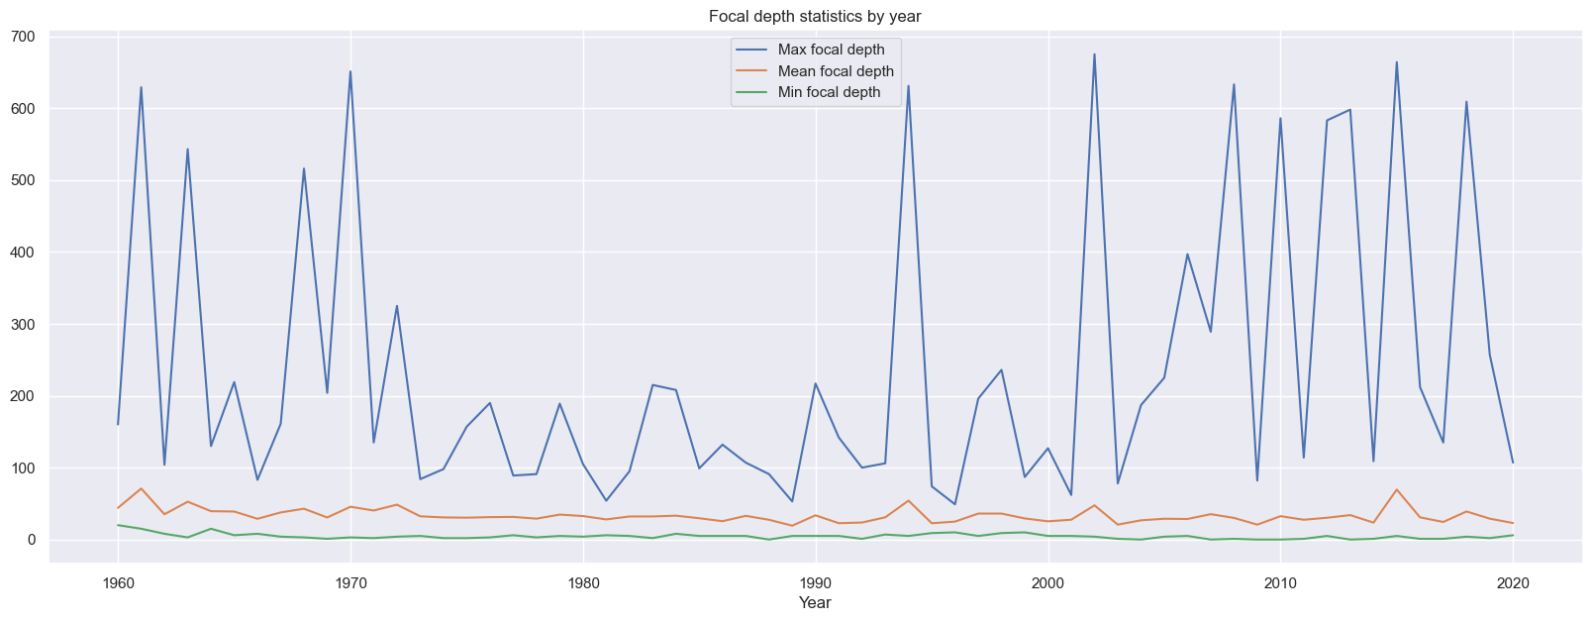
Focal depth over years

Slide 35
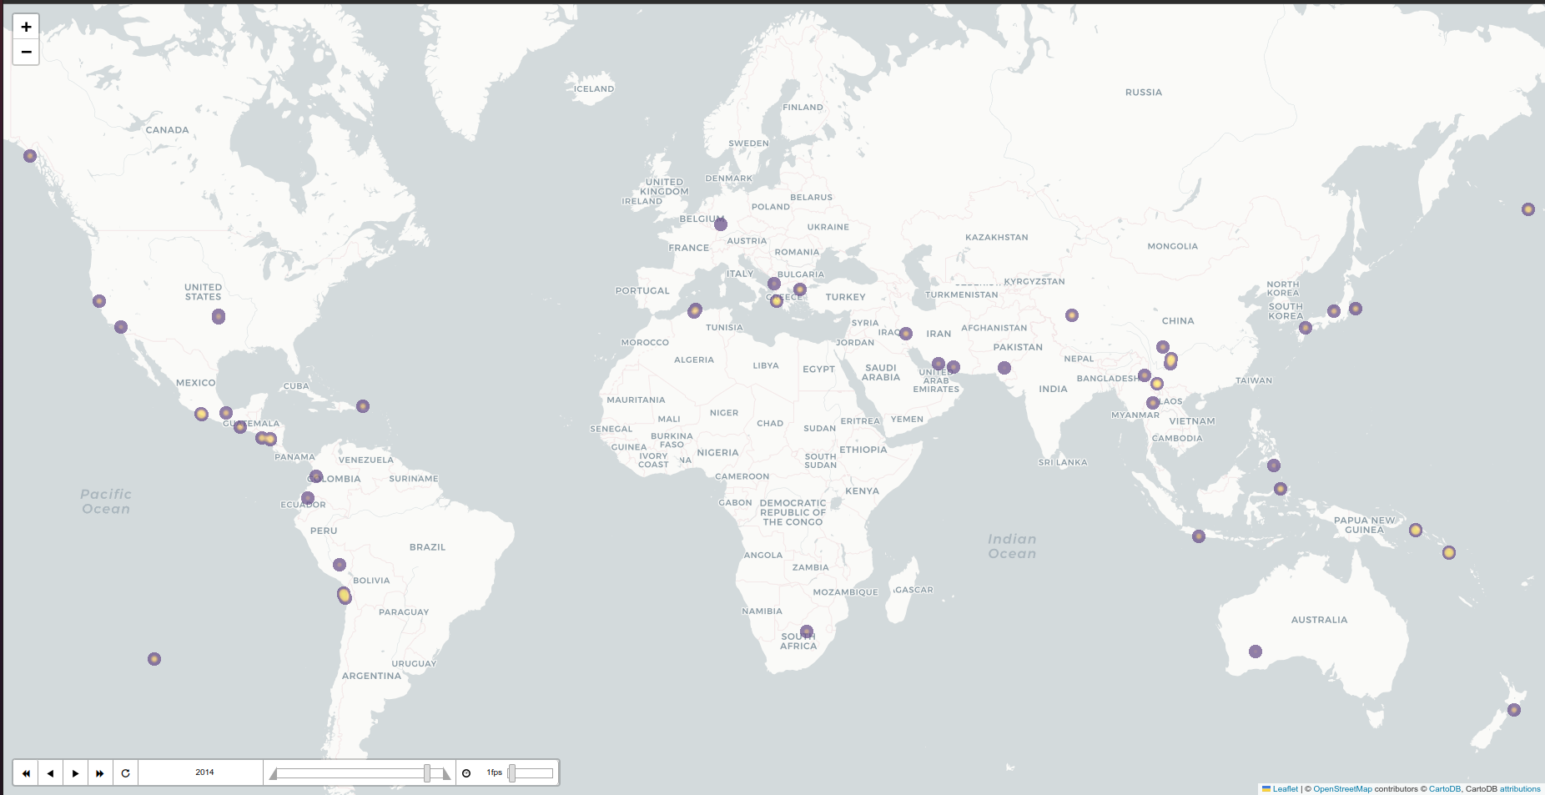
Map of earthquakes by years – external file

Slide 36

Country statistics

Slide 37
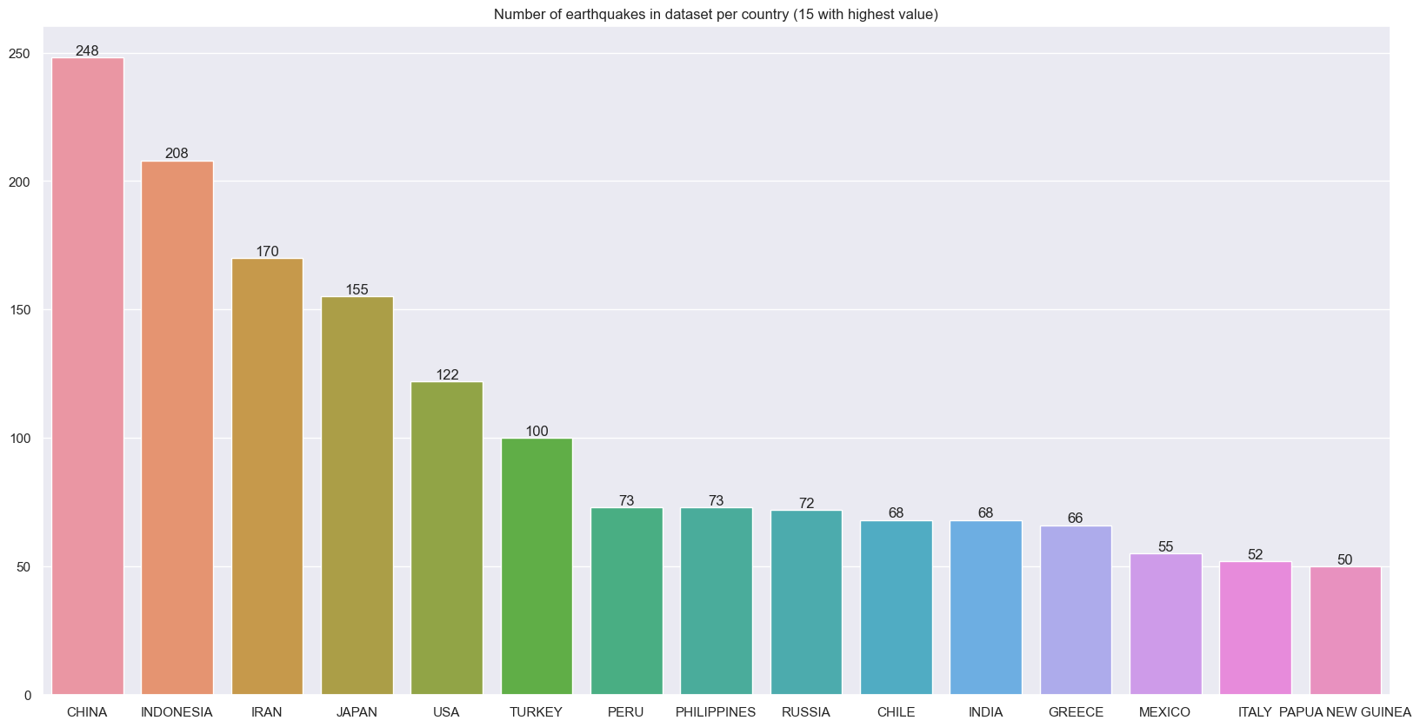
15 countries with most earthquakes

Slide 38
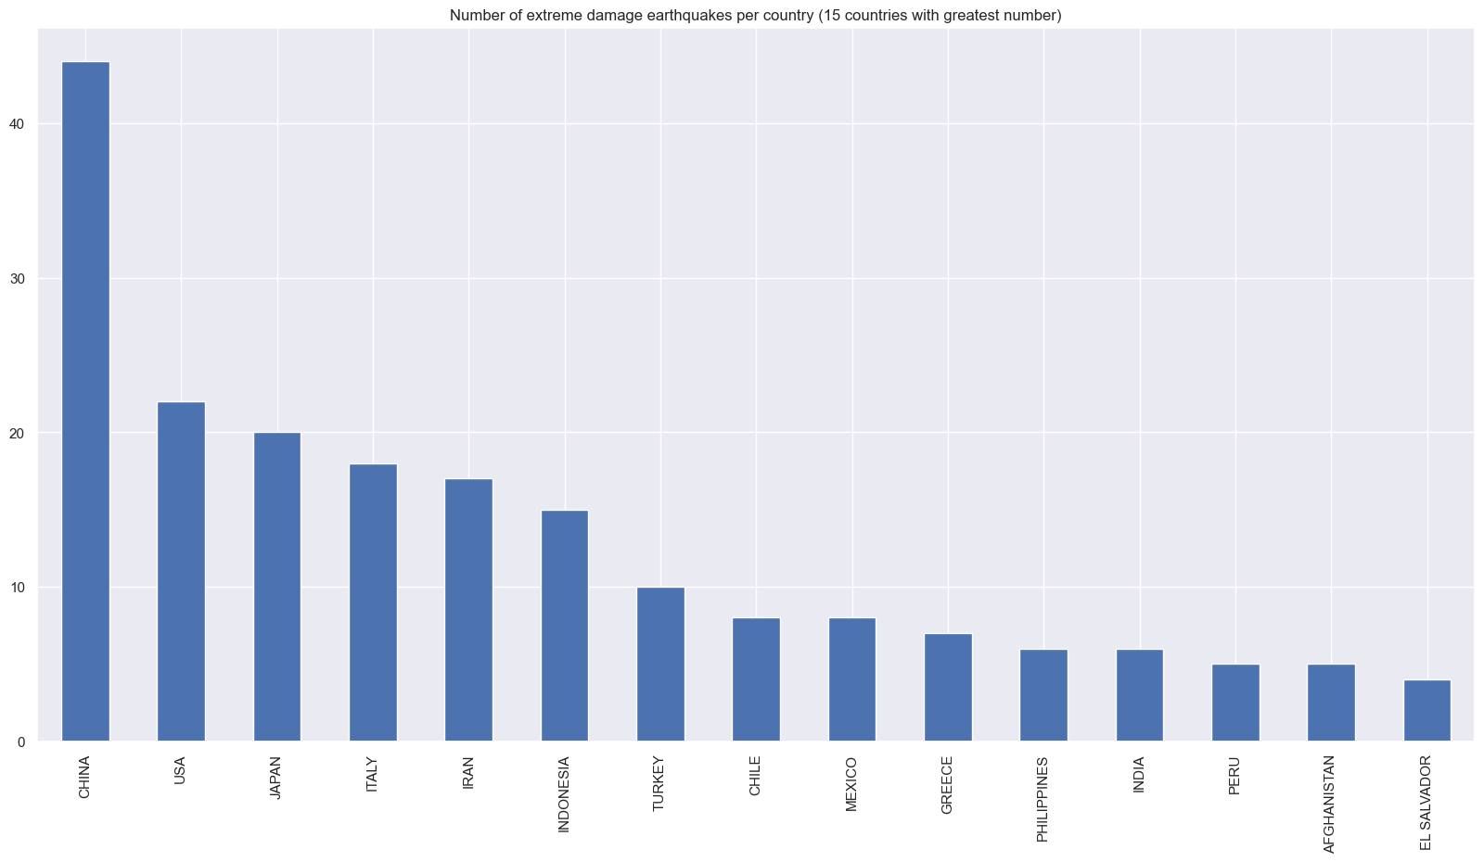
15 countries with highest number of extreme damaged earthquakes

Slide 39
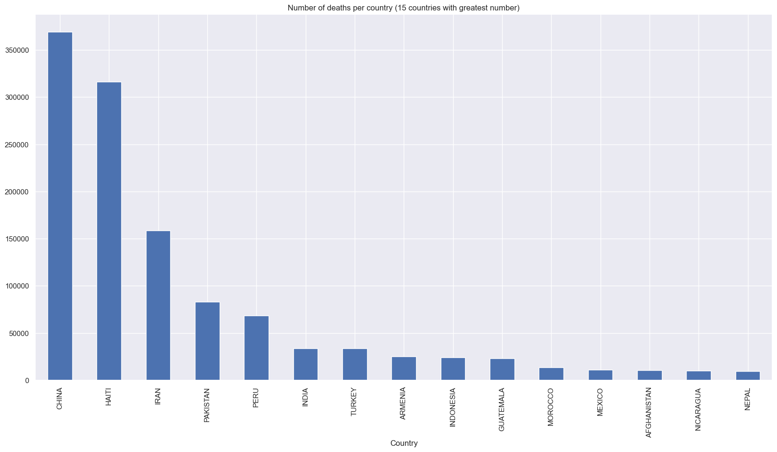
15 countries with most death counts

Slide 40
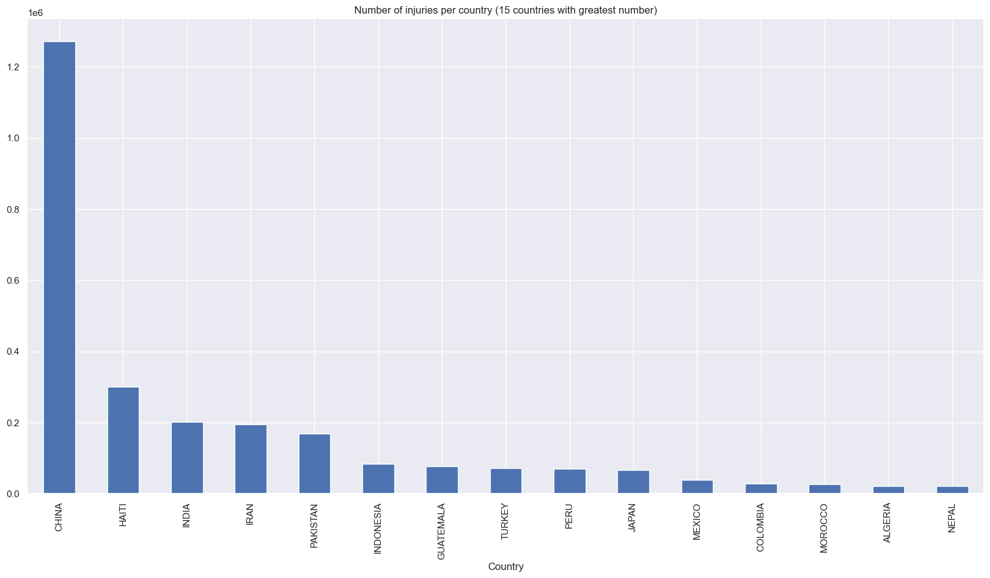
15 countries with most injured counts

Slide 41
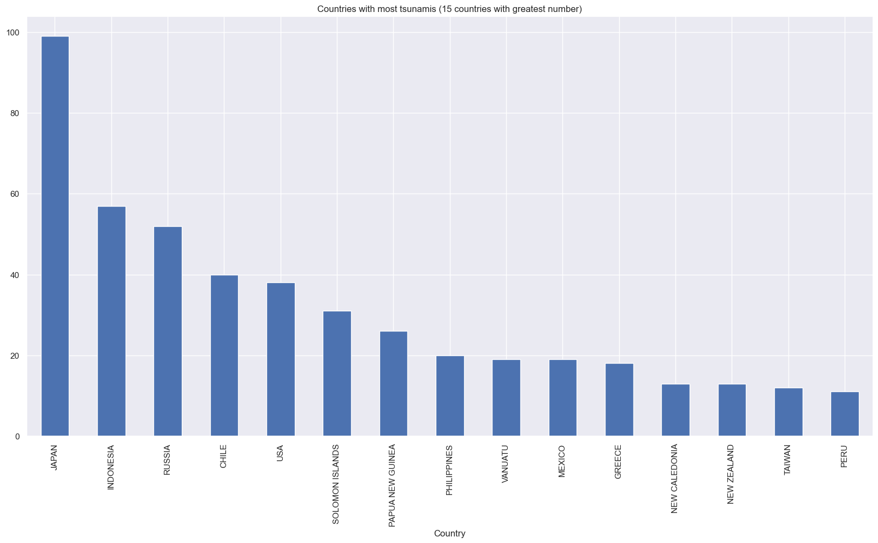
15 countries with most tsunamis

Slide 42
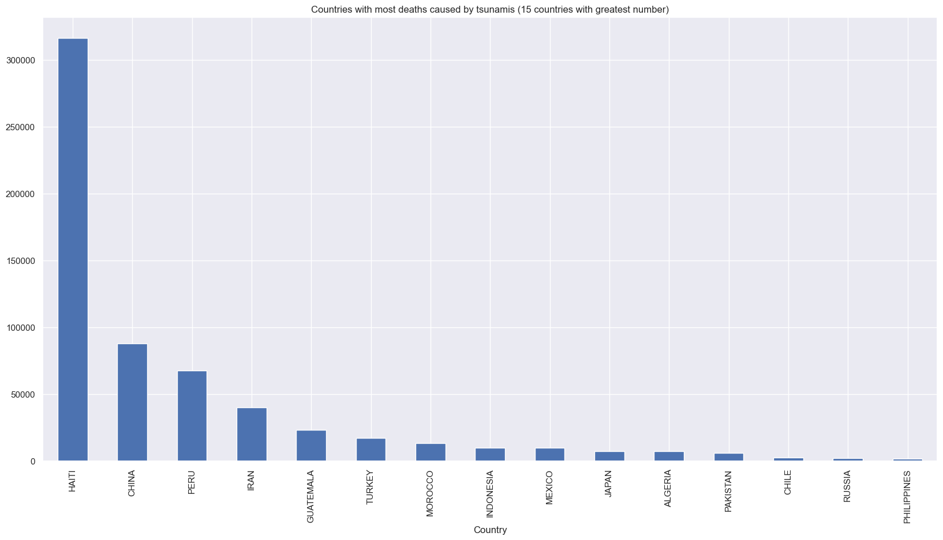
15 most countries for death count by tsunamis

Slide 43
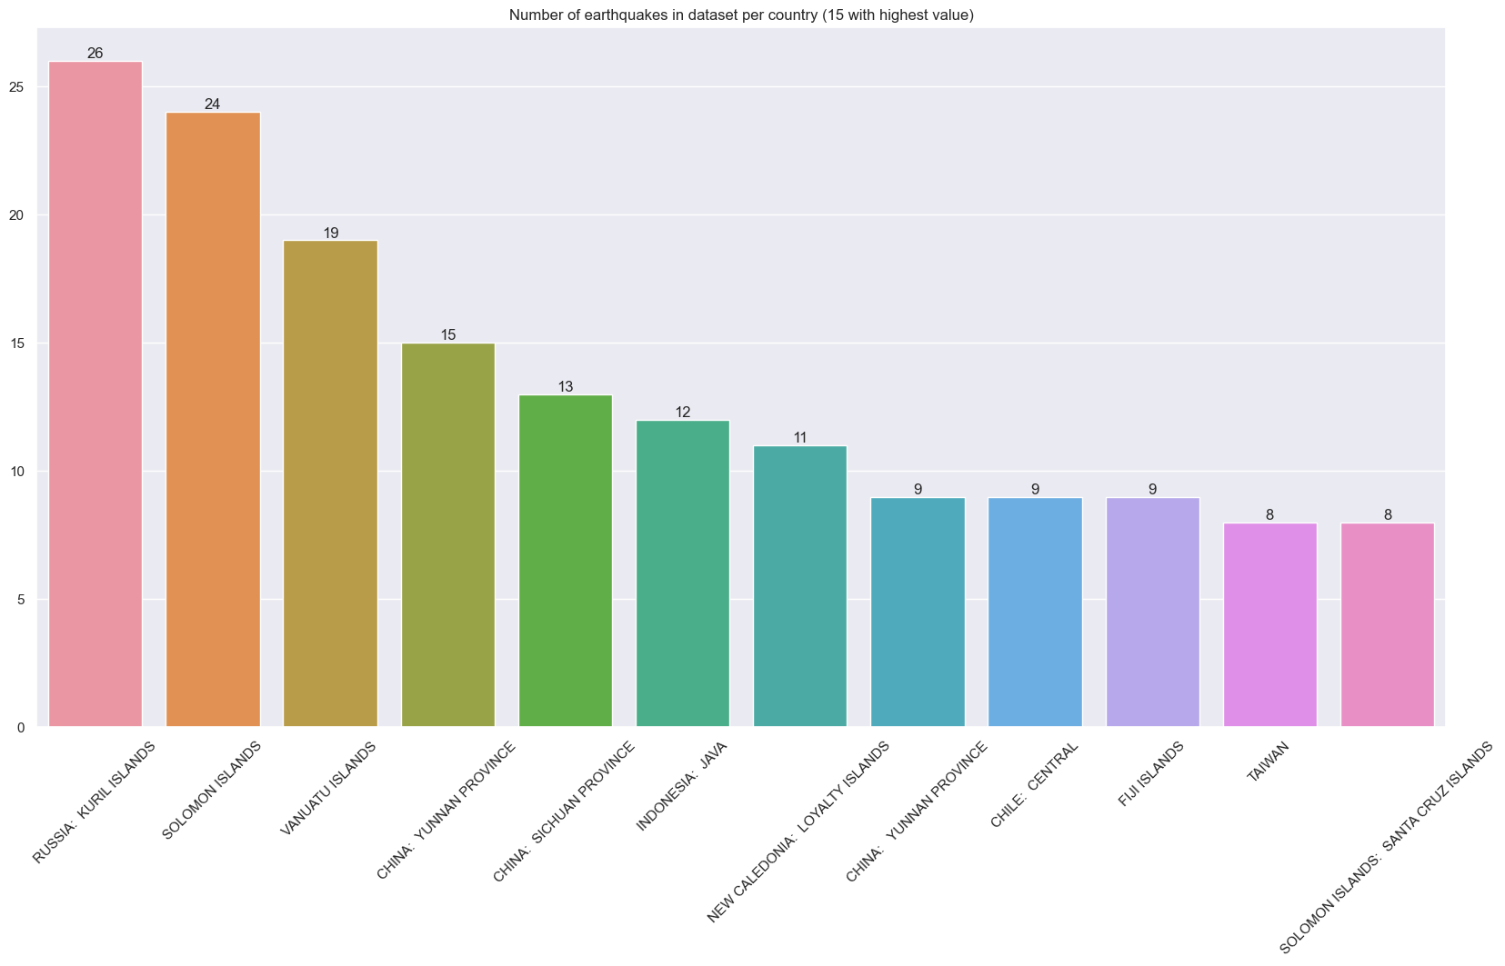
15 locations with most earthquakes

Slide 44
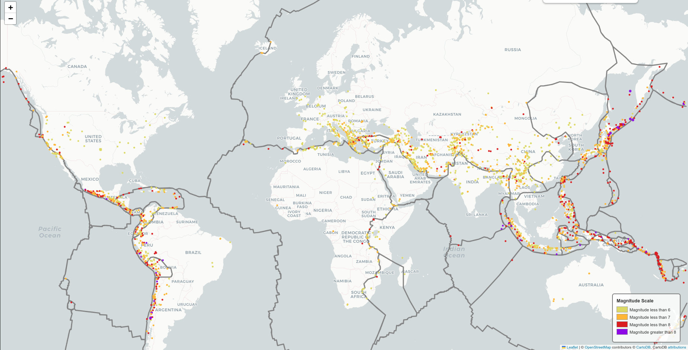
Map of magnitudes – external file

Slide 45


Material damage

Slide 46
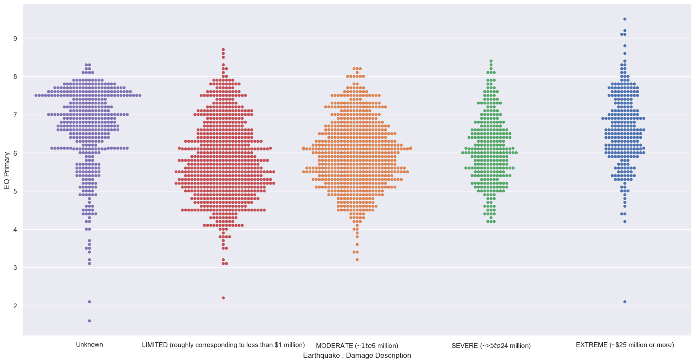
Relationship between damage and magnitude

Slide 47
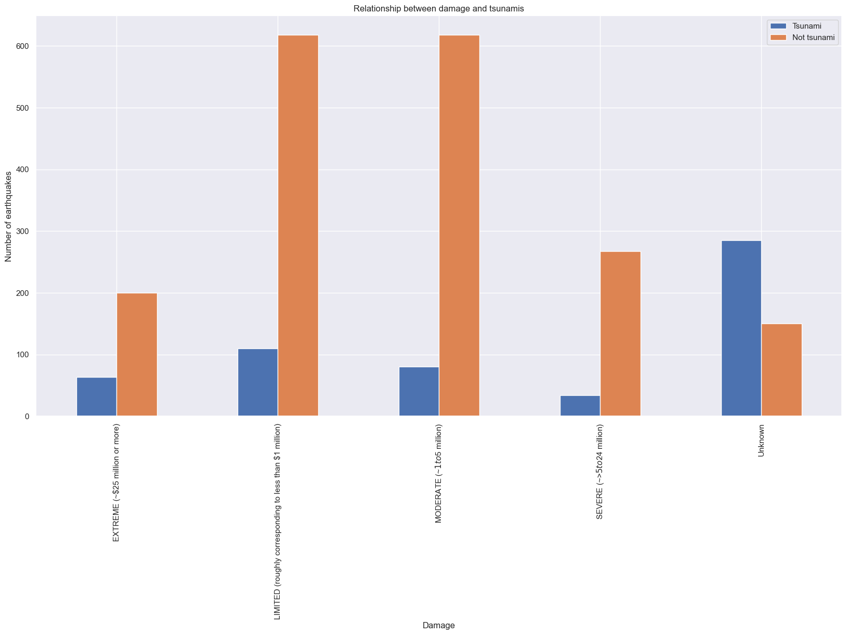
Damage of tsunamis and normal earthquakes

Slide 48
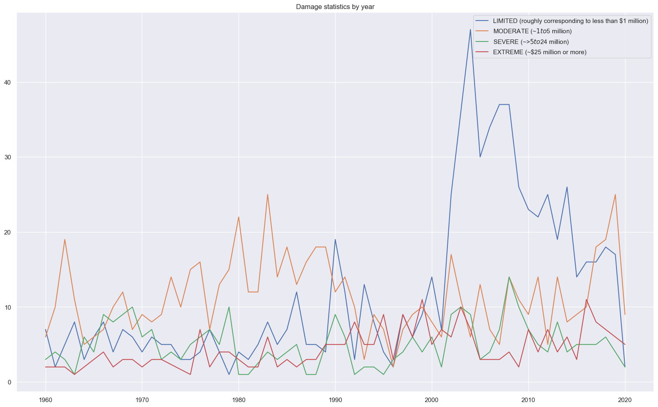
Damage categories over years

Slide 49
Number of casualties statistics

Slide 50
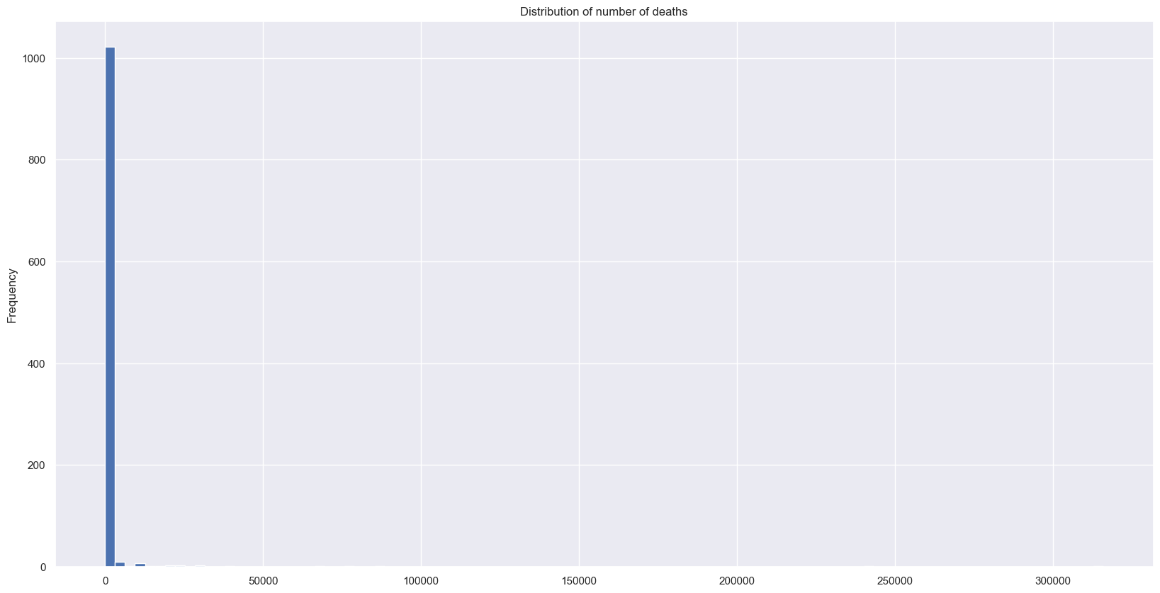
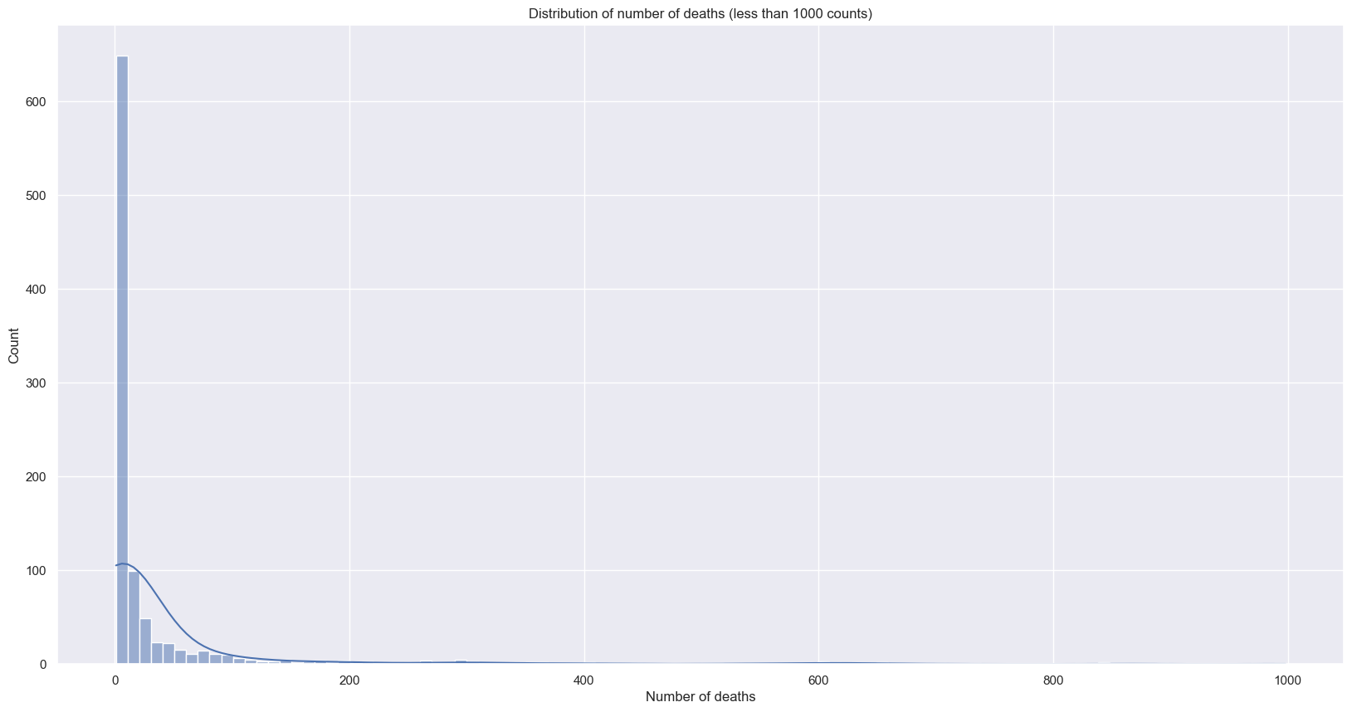
Number of deaths distribution

Slide 51
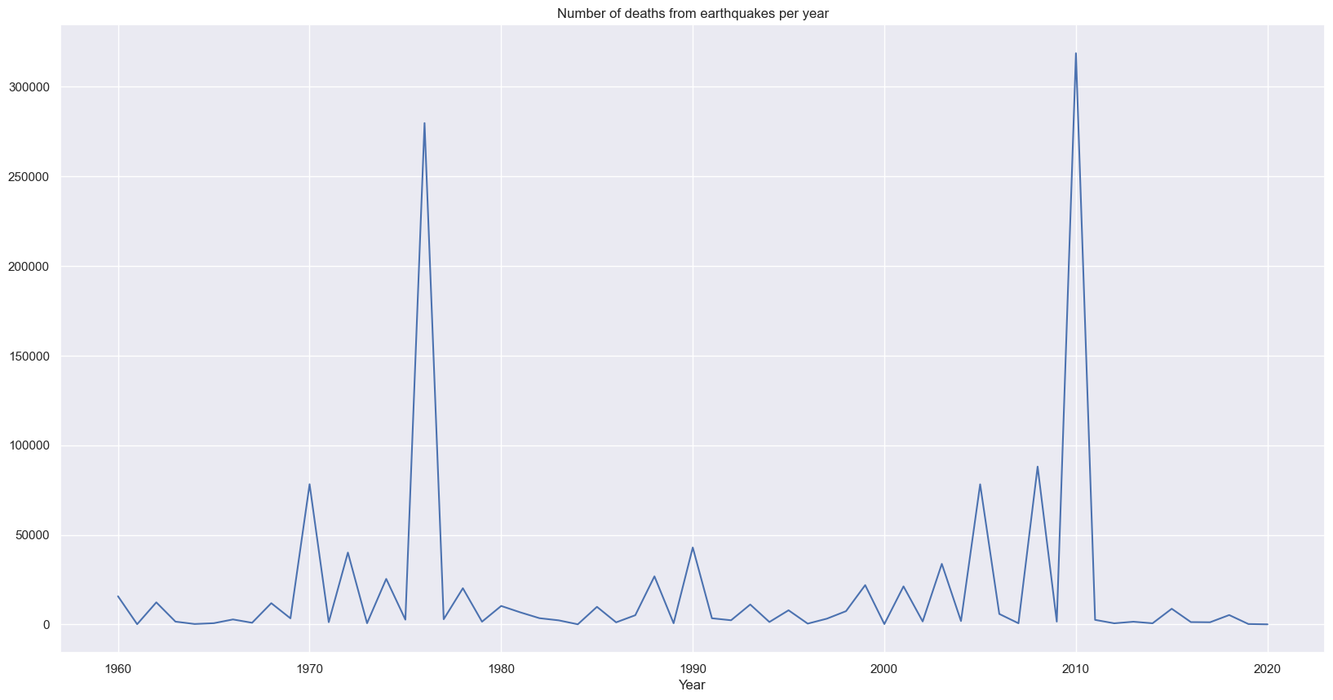
Number of casualties per year

Slide 52
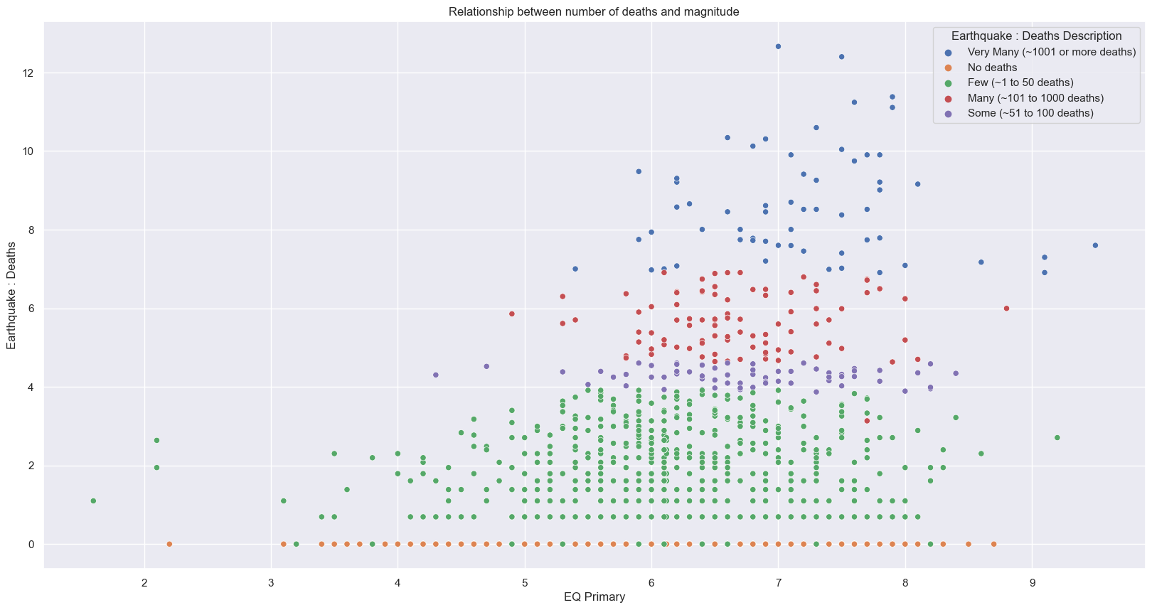
Relationship between casualties and magnitude

Slide 53
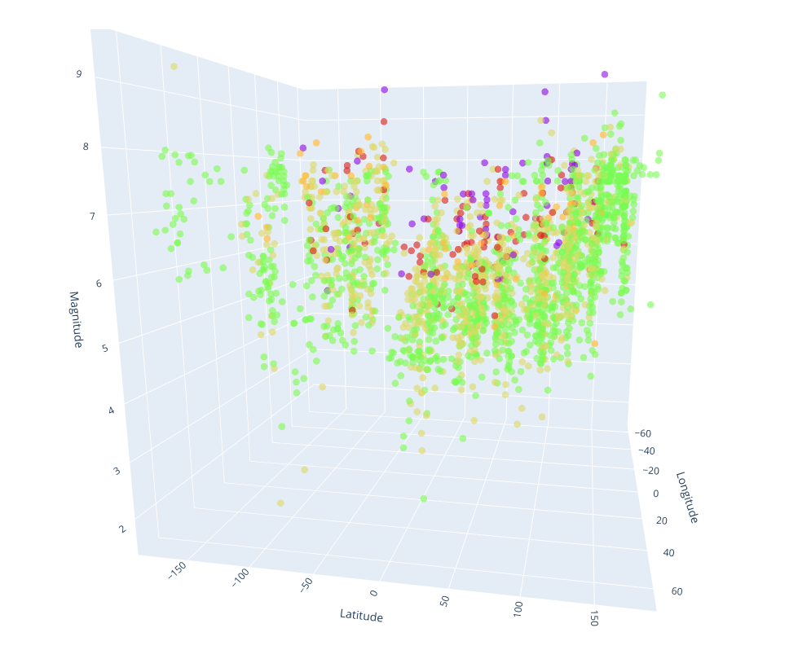
How number of deaths depend on coordinates and magnitude – 3D plot (external file)

Slide 54
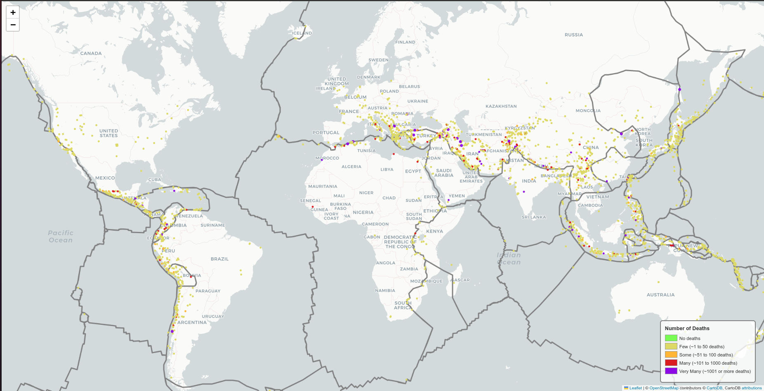
Number of deaths map – external file

Slide 55
Number of injuries analysis
This is very similar to number of deaths, so we will not show results in presentation
All statistics are available in notebook

Slide 56

Turkey earthquakes

Slide 57
Basic stats
Number if earthquakes in Turkey: 100 (1960-2020)
Number of significant earthquakes per year in Turkey: 1.64
Turkey is on 37th place in the world by maximum magnitude earthquake.
Turkey is on 6th place in the world by number of earthquakes.
Turkey is on 7th place in the world by number of deaths.

Slide 58
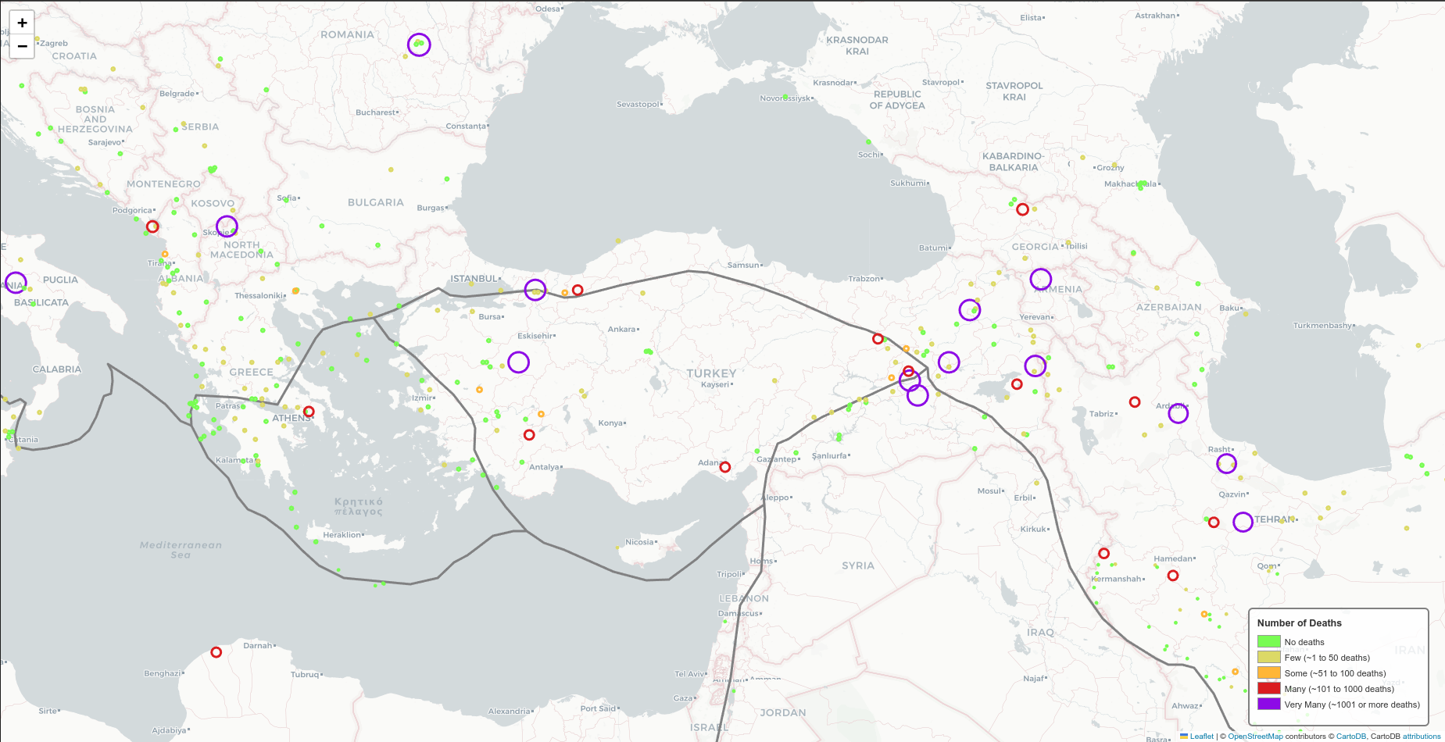

Slide 59
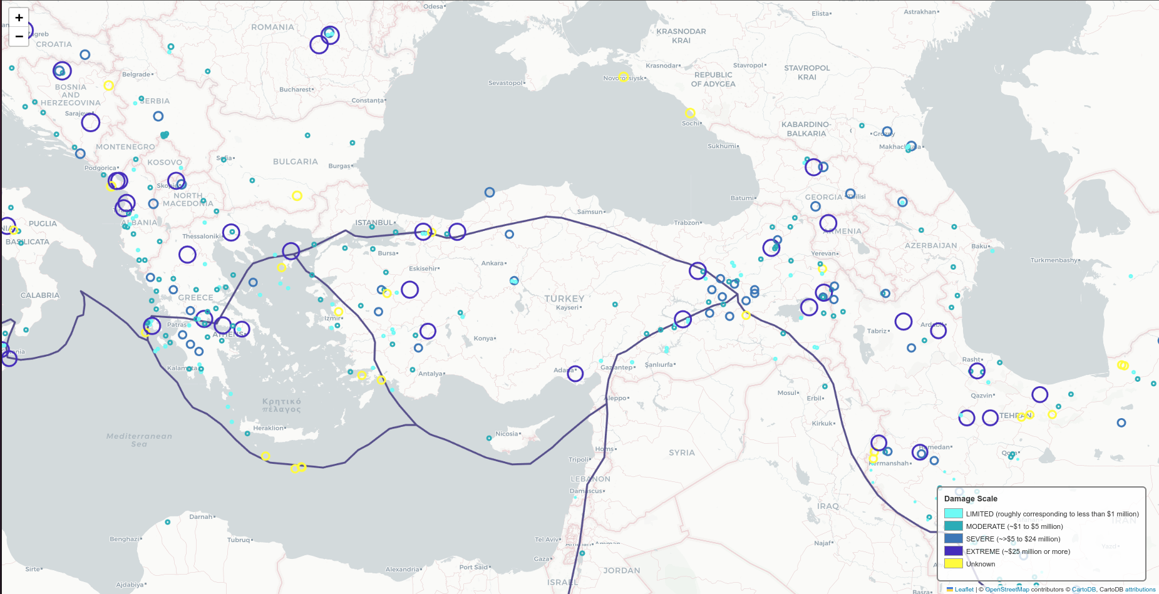

Slide 60
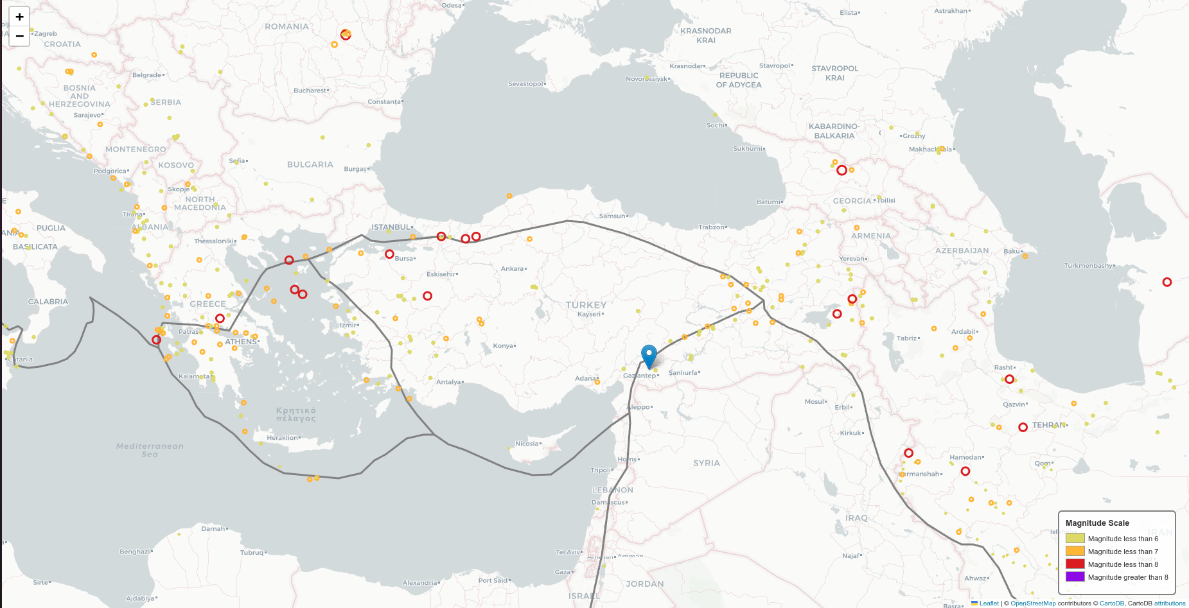
Magnitudes map – 2023. Earthquake in turkey

Slide 61

Turkey earthquake 2023. - was it expected ?
Turkey earthquake 2023. Information:
7.8 magnitude
50783 deaths
107204 injuries
Depth: 10km
Maximum number of deaths in Turkey (1960 - 2020): 17118

Slide 62

Serbia earthquake statistics

Slide 63
Basic stats
Number if earthquakes in Serbia: 8 (1960-2020)
Number of significant earthquakes per year in Serbia: 0.13
Serbia is on 99th place in the world by maximum magnitude earthquake.
Serbia is on 46th place in the world by number of earthquakes.
Serbia is on 75th place in the world by number of deaths.

Slide 64

Earthquakes in serbia (1960-2020)

Slide 65


Slide 66


Tsunami analysis

Slide 67


Slide 68

Number of deaths caused by tsunamis and earthquakes per year

